Slide 1
Recent Trend in NLP (by TA)
Natural Language Processing

Slide 2
Intent Detection

Slide 3
Understanding Intent Detection tasks
Outline
An Evaluation of Dataset for intent Classification and out-of-scope Prediction
Efficient Intent Detection with Dual Sentence Encoders
Few shot intent detection via Contrastive Pretrain and Fine-tuning
Discriminative Nearest neighbor Few shot intent detection by Transferring language inference
Emergent linguistic structure in artificial neural networks trained by self-supervision

Slide 4
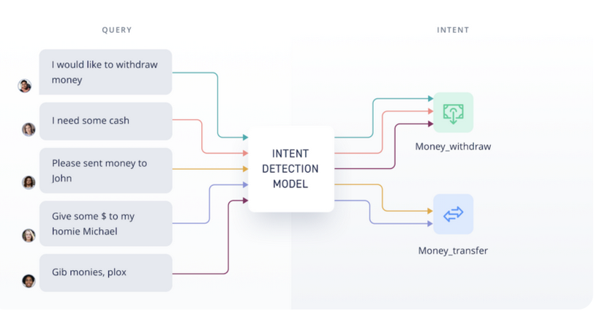
An Example of system

Slide 5
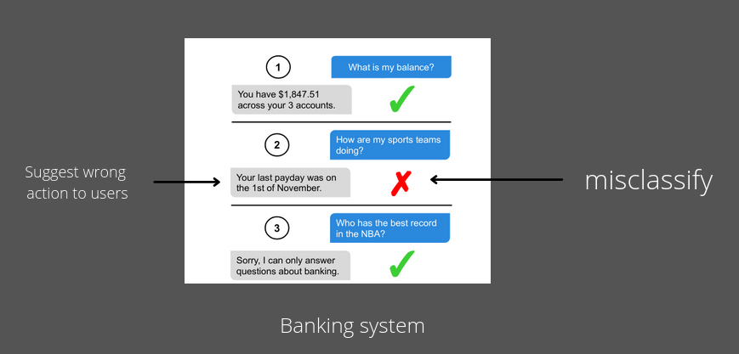
The problem

Slide 6
Metrics
Accuray over 150 intents to evaluate
Recall on out-of-scope queries to evaluate

Slide 7
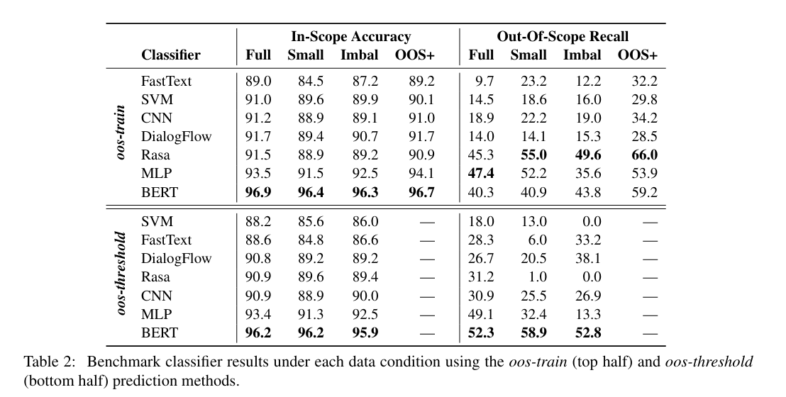

Slide 8
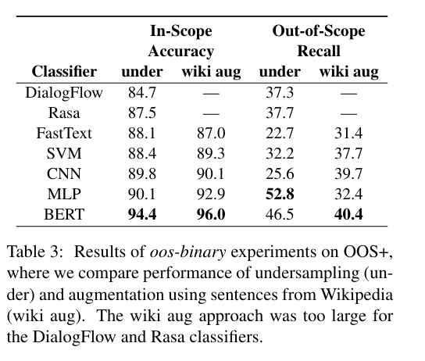

Slide 9
Efficient Intent Detection with Dual Sentence Encoders
Core idea:
Use Conversational pretraining instead of (LM-base)
input -> ConverT -> o1
Input -> USE -> o2
Combine o1 and o2 to the same classifier
Train only classifier without encoders
use the mean-pooled "sequence o/p"
pool is the sub-word embeddings as sentence representation
What they good at ?
They learn i/p context and relevance follow up (response)

Slide 10
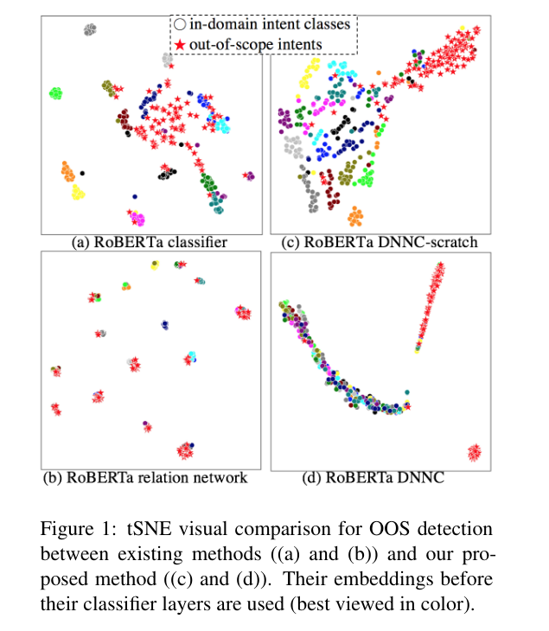
Discriminative Nearest Neighbor Few-Shot Intent Detection
by Transferring Natural Language Inference

Slide 11
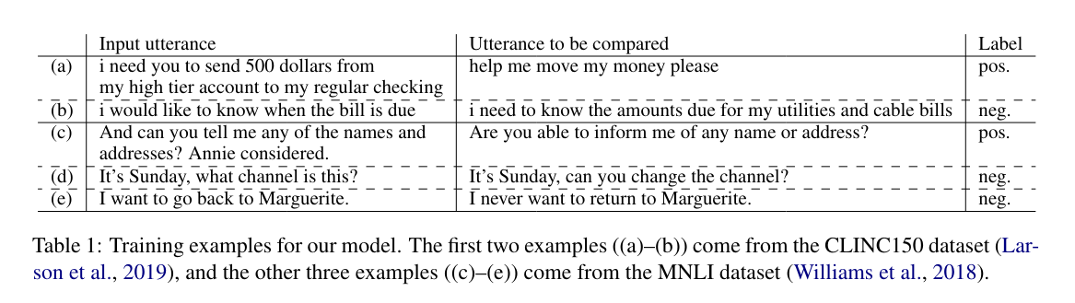

Slide 12
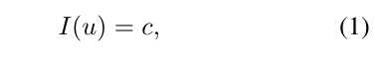
Background knowledge
2.1 Task: Few-Shot Intent Detection
C: Predefine class
Any utterance can be OOS as long as does not fall into any N intent classes
Balanced K-shot learning
Each class have K examples for each of N classes
Total sample = N * K training examples
ej,i ∈ E, where E is the set of the examples ; i-th training with j-th class Cj

Slide 13
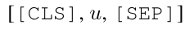
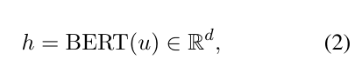
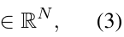
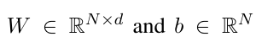
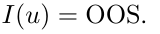
2.2 Multi-Class Classification
The goal is to achieve high acc on intent classification and out-of-scope detection
Input format :
Hidden representations:
d ~ dimensional vector correspond to special token [CLS]
p(c|u) = softmax(Wh + b)
Trained on cross entropy loss
At inference take P(c= Cj | u) largest value then output I(u) = Cj

Slide 14
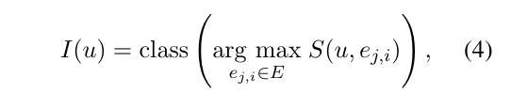
2.3 Nearest Neighbor Classification
Basic idea : to classify an input into the same class of most relevant training example
This function will return intent (class) of training example ej,i
S is function estimate some relevance score
If relevant score > T then I(u) = OOS

Slide 15
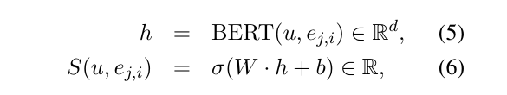
Propose Method look like
3. The main idea
model inter-utterances relationship in their nearest neighbors classification
i/p -> model -> binary o/p
Using pairwise example with seamless transfer of NLI
3.1 Deep pairwise Matching function

Slide 16
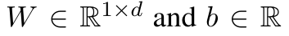
Input format : [[CLS], u,[SEP], ej,i, [SEP]]
σ is the sigmoid function
Recap
step 1. using h = BERT(u, eji) subset of Rd by changing i/p format : [[CLS] ,u, [SEP], eji, [SEP]]
step 2. S(u,eji) = sigmoid(W@h + b)

Slide 17
3.2 Discriminative Training
S(u, eji)
closed to 1.0 if u and eji are belong same class otherwise 0.0 trained by using binary cross entropy
Neg considered all any possible pairs across two any different class

Slide 18
3.3 Seamless Transfer from NLI
Using transfer learning another inter-intent relation tasks
Task whether the hypothesis are entailed by a premise sentence
Binary classification
Using Pretrain model with NLI task
No need to modify model architecture as task format is consistent

Slide 19
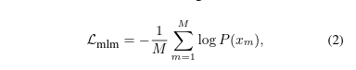
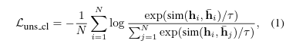
Few shot intent detection
Pretrain model (stage 1)
i-th - user utterance through an encoder model
h - last hidden representation
hi = BERT(ui)
*** Positive pairs : hidden representation that come from the same utterance with different augmented that sample
Lstage1 = Luns cl + λLmlm

Slide 20
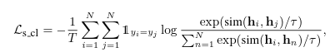
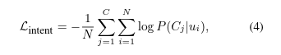
Fine-tuning models (stage 2)
*** Positive pairs : hidden representation that come from the same class

Slide 21
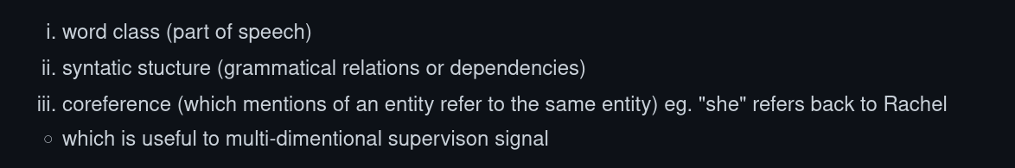
Emergent linguistic structure in Ann trained by self-supervison
What model can capture

Slide 22
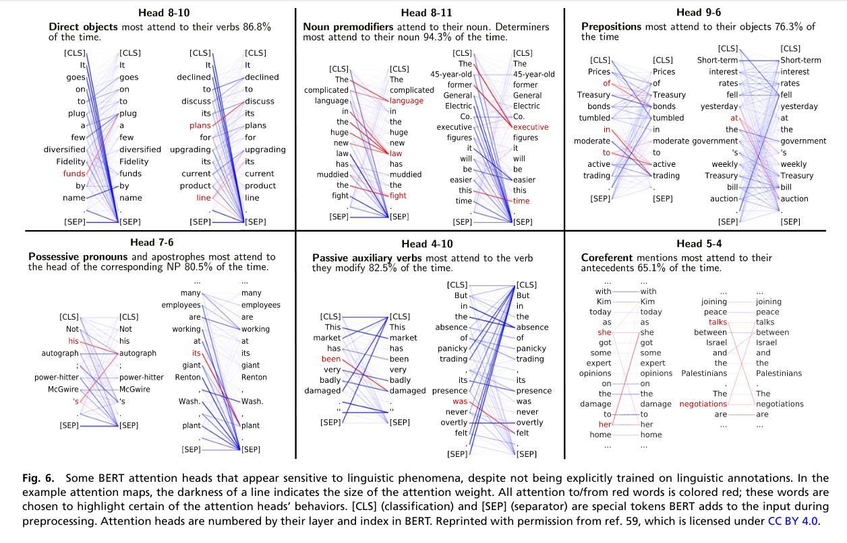

Slide 23
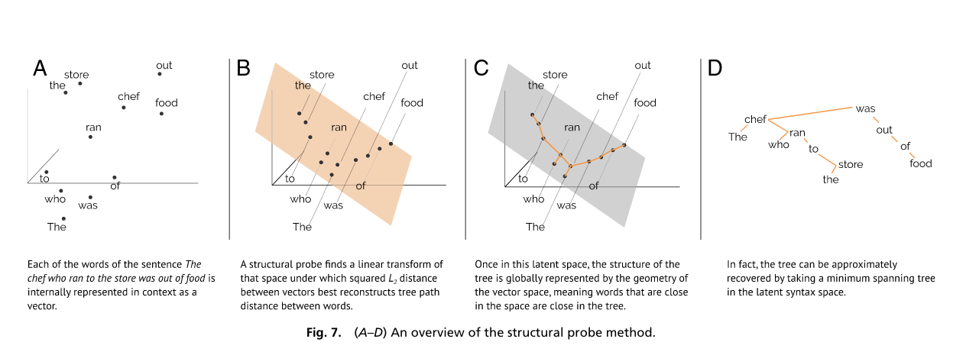

Slide 24
Text Summarization

Slide 25
Papers
Pre-trained objective for abstractive text summarization
PEGASUS: Pre-training with Extracted Gap-sentences for Abstractive Summarization
Source document length limitation
Longformer: The Long-Document Transformer
Factual Inconsistency
BERTScore: Evaluating Text Generation with BERT
Notes:
All about text sum
But from different angles

Slide 26
Pre-trained objective for abstractive text summarization
PEGASUS: Pre-training with Extracted Gap-sentences for Abstractive Summarization
Without PEGASUS
No pre-training objectives tailored for abstractive text summarization
A lack of systematic evaluation across diverse domains.
With PEGASUS
Self-supervised objective: Gap Sentences Generation
Low-resource summarization
Notes:
A lot of recent models are transformers-based which are pretrained on large text corpora and then fine-tuned on many downstream tasks like QA, Text Classification
Text Sum is just one of them
And also, these pre-trained model are normally evaluated using the same domain dataset as the one they were finetuned on.
Devel a pretrianing obj

Slide 27
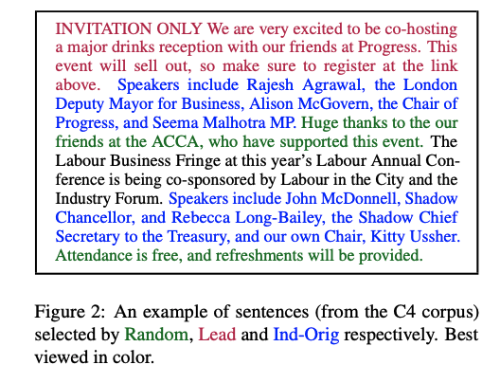
Pre-trained objective for abstractive text summarization
PEGASUS: Pre-training with Extracted Gap-sentences for Abstractive Summarization
Mask whole sentences from documents, [MASK1]
→ Random Uniformly select m sentences at random.
→ Lead Select the first m sentences.
→ Principal Select top-m scored sentences according
to importance: Ind-Orig, Seq - Orig, Seq- Uniq ….
Notes:
Introduce sentence masking

Slide 28
Pre-trained objective for abstractive text summarization
PEGASUS: Pre-training with Extracted Gap-sentences for Abstractive Summarization
Mask word, [MASK2], total of 15%
→ (1) 80% of time replaced by a mask token [MASK2]
→ (2) 10% of time replaced by a random token
→ (3) 10% of time unchanged
Notes:
Apart from sentence masking,
Similar to BERT

Slide 29
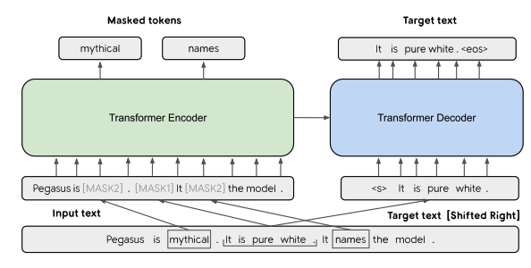
Pre-trained objective for abstractive text summarization
PEGASUS: Pre-training with Extracted Gap-sentences for Abstractive Summarization
Pretrained on C4 and HugeNews

Slide 30
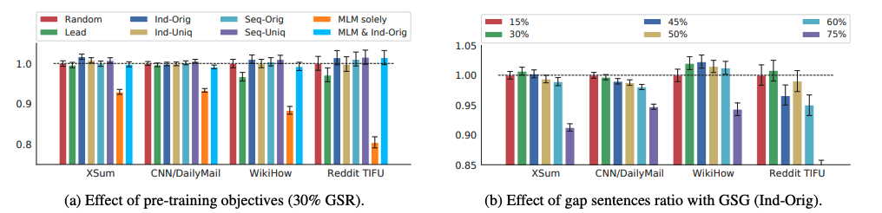
Pre-trained objective for abstractive text summarization
PEGASUS: Pre-training with Extracted Gap-sentences for Abstractive Summarization
→ Ind-Orig with 30% GSR
Notes:
Many variants of masking types
optimal

Slide 31
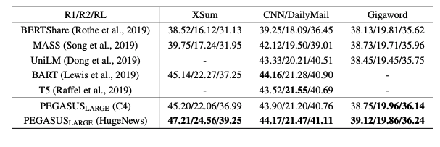
Pre-trained objective for abstractive text summarization
PEGASUS: Pre-training with Extracted Gap-sentences for Abstractive Summarization
We jointly trained MLM with GSG Ind-Orig (MLM & Ind-Orig), which masks 30%
sentences and extra 15% tokens in unselected sentences,
Notes:
Recent work pre-training Transformers with self-supervised objectives on large text corpora has shown great success when fine-tuned on downstream NLP tasks including text summarization
pre-training objectives tailored for abstractive text summarization have not been explored
ROUGE1-
F1 (Lin, 2004) between the sentence and the rest of the
document

Slide 32
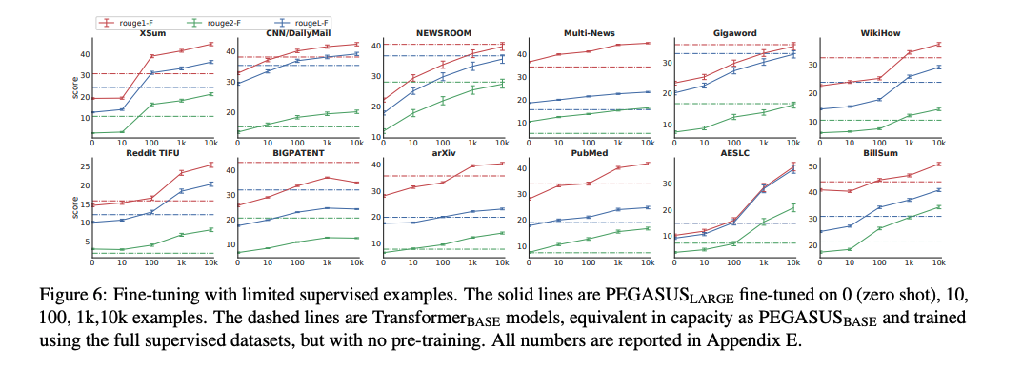
Pre-trained objective for abstractive text summarization
PEGASUS: Pre-training with Extracted Gap-sentences for Abstractive Summarization
Low resource setting
Notes:
Recent work pre-training Transformers with self-supervised objectives on large text corpora has shown great success when fine-tuned on downstream NLP tasks including text summarization
pre-training objectives tailored for abstractive text summarization have not been explored
ROUGE1-
F1 (Lin, 2004) between the sentence and the rest of the
document

Slide 33
Pre-trained objective for abstractive text summarization
PEGASUS: Pre-training with Extracted Gap-sentences for Abstractive Summarization
Low resource setting
PEGASUS large beat previous state-of-the-art results on 6 out of 12 datasets with only 1000 fine-tuning examples.
On CNN/DailyMail, with half the number of parameters, PEGASUS large demonstrated better zero-shot (ROUGE2-F=13.28) performance than GPT-2 (ROUGE2- F=8.27).
Using only 1000 examples, PEGASUS large achieved ROUGE2-F of 19.35, much higher than the 13.1obtained in Khandelwal et al. (2019) with 3000 examples.
Notes:
Recent work pre-training Transformers with self-supervised objectives on large text corpora has shown great success when fine-tuned on downstream NLP tasks including text summarization
pre-training objectives tailored for abstractive text summarization have not been explored
ROUGE1-
F1 (Lin, 2004) between the sentence and the rest of the
document

Slide 34
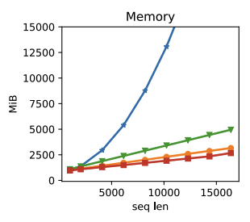
Source document length limitation
Longformer: The Long-Document Transformer
Without Longformer
Self-attention scales quadratically with sequence length
→ huge computational cost
Limited to 512-token long document
Workarounds for > 512-token long documents
→ Truncation
→ Chunk, process, combine
→ two-stage model, retrieve and then model
Information loss, cascading errors
Notes:
One limitation of is length limitation
Many recent models are pretrained-transformer based with length limitation of 512 tokens

Slide 35
Source document length limitation
Longformer: The Long-Document Transformer
With Longformer
New attention mechanism by combining a local windowed attention with a task motivated global attention
→ scales linearly with sequence length
Is feasible for upto 16k token long documents
Process all context in a single pass

Slide 36
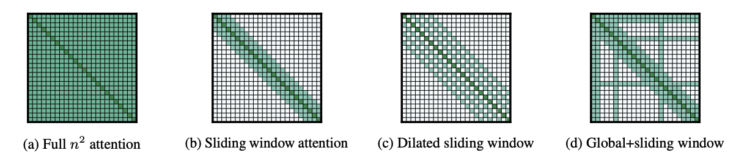
Source document length limitation
Longformer: The Long-Document Transformer
Attention Pattern

Slide 37
Source document length limitation
Sliding Window Attention
Similar to CNN
a fixed-size window attention surrounding each token
multiple stacked layers of such windowed attention results in a large receptive field
top layers have access to all input locations and have the capacity to build representations that incorporate information across the entire input

Slide 38
Source document length limitation
Dilated Attention
Similar to dilated CNN
Increase receptive field without increasing computation
Some heads without dilation to focus on local context
Some heads with dilation focus on longer context

Slide 39
Source document length limitation
Global Attention
Like [CLS] in BERT
Windowed and dilated attention are not flexible enough to learn task-specific representations
Added global attentions on few pre-selected input location
→ [CLS] for QA

Slide 40
Source document length limitation
Encoder
Small window sizes without dilation for the lower layers
→ Local information
→ To maximize their capacity to learn and utilize the immediate local context.
Increase window sizes as we move to higher layers
→ Higher-level representation of the entire sequence
Higher layers, small amount of increasing dilation only on 2 heads
→ Give the model the ability to directly attend to distant tokens
without sacrificing local context
Decoder
Full self-attention to the entire encoded tokens and to previously decoded locations.

Slide 41
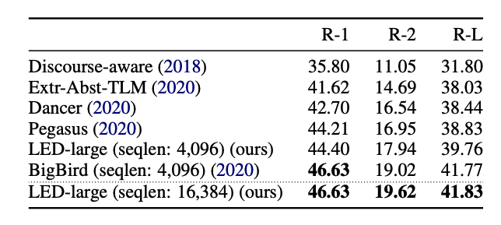
Source document length limitation
Longformer: The Long-Document Transformer

Slide 42
Factual Inconsistency
BERTScore: Evaluating Text Generation with BERT
Without BERTScore
Lexical Overlap
→ n-gram overlaps between 2 texts
→ ROUGE
→ Fails to robustly match paraphrases
→ Fails to capture distant dependencies and semantically-critical ordering changes
Notes:
ROUGE standard
A because of B
B becuase of A

Slide 43
Factual Inconsistency
BERTScore: Evaluating Text Generation with BERT
With BERTScore
Semantic Overlap
→ BERTScore
→ BERTSCORE computes the similarity of two sentences as a sum of cosine similarities
between their tokens’ embeddings

Slide 44
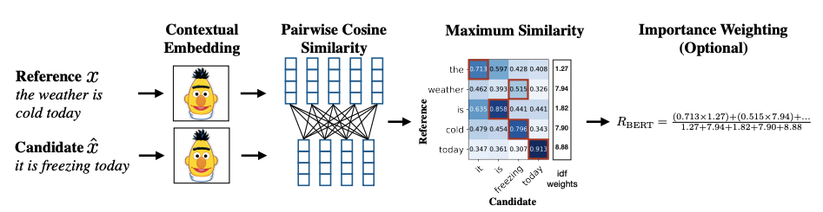
Factual Inconsistency
BERTScore: Evaluating Text Generation with BERT
Notes:
Token Representation: We use contextual embeddings to represent the tokens in the input sentences x and xˆ.

Slide 45
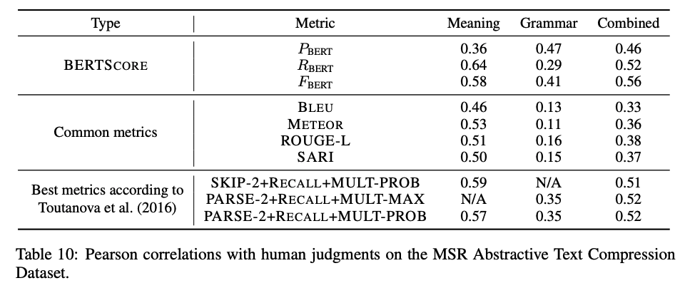
Factual Inconsistency
BERTScore: Evaluating Text Generation with BERT
Pearson correlation between BERTSCORE and the three types of human scores.
→ meaning: how well a compressed text preserve the meaning of the original text
→ grammar: how grammatically correct a compressed text is
→ combined: the average of the meaning and the grammar scores
Notes:
RBERT has the highest correlation with human meaning judgments, and PBERT correlates highly with human grammar judgments. FBERT provides a balance between the two aspects

Slide 46
Depression Detection
Notes:
Interesting technique
Application in real world
General techniques in text classification

Slide 47
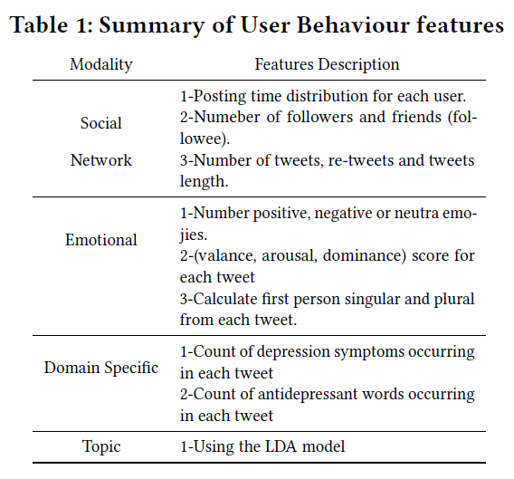
DepressionNet: A Novel Summarization Boosted Deep Framework for Depression Detection on Social Media
Previous studies to have largely relied upon the user behaviour and their linguistic patterns including user’s social interactions.
Downside is that these models are trained on several irrelevant content which might not be crucial for detecting a depressed user.
Besides, these content have a negative impact on the overall performance of the Model.
We propose a novel computational framework for that initially selects relevant content through a hybrid extractive and abstractive summarization strategy on the sequence of all user tweets leading to a more fine-grained and relevant content.
The content then goes to our novel deep learning framework comprising of a unified learning comprising of CNN coupled with attention-enhanced GRU models
better empirical performance than existing baselines.

Slide 48
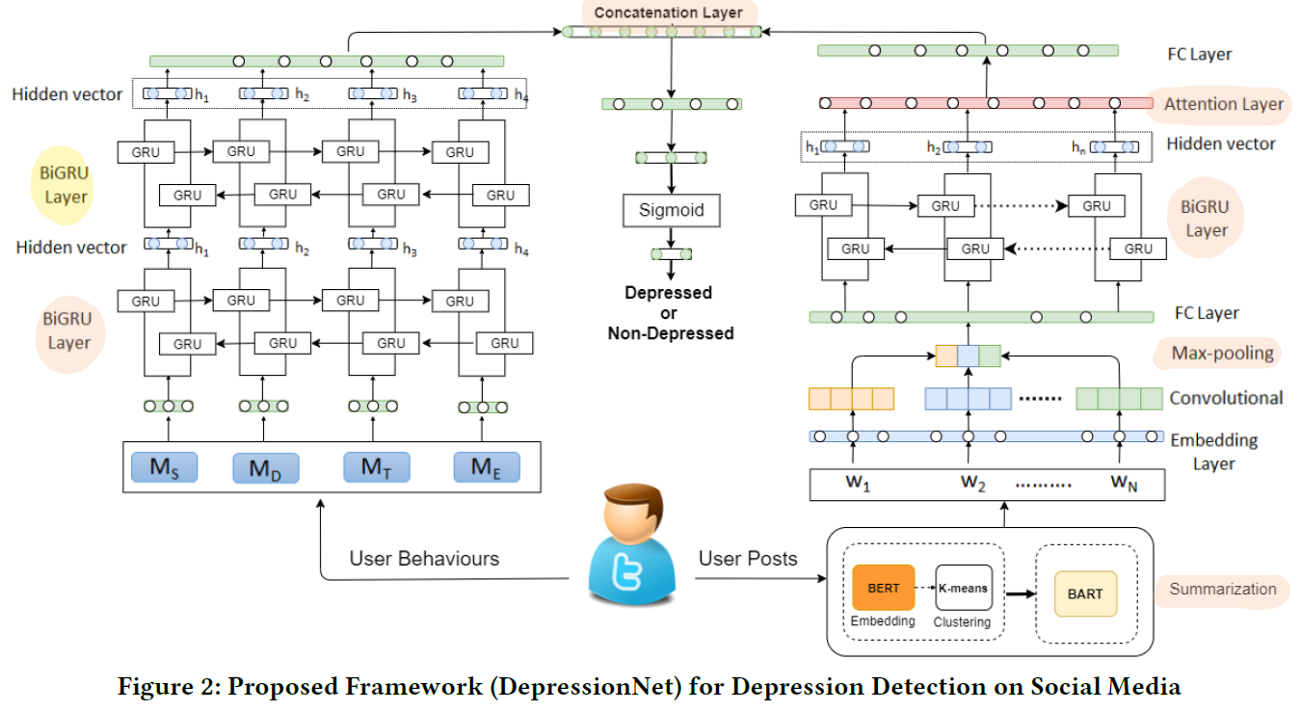
DepressionNet: A Novel Summarization Boosted Deep Framework for Depression Detection on Social Media
Curse of dimensionality from irrelevant posts
Automatic Text summarization : incorporate abstractive and extractive summarisation BERT-BART
Then the word embeddings are fed to CNN stacked with BiGRU with attention
User behaviour Modelling : group the features into 4 types
Applied Stacked BiGRU for each features
Fusion of User Behaviour and Post History
Concatenate both representations to generate a feature map for binary classification
Notes:
We then perform 𝑘-means clustering on high dimensional vector representing semantic centers of text, the cluster centres are selected to extract most important tweets
further condense
BART structure consists of two components: an encoder and a decoder. The encoder component is a bi-directional encoder compliant with the BERT architecture and the decoder component is an auto-regression decoder that follows GPT settings
The word embeddings are then used as input to the stacked Convolutional Neural Network (CNN) and Bidirectional Gated Recurrent Units (BiGRU) with attention model to capture sequential information,

Slide 49
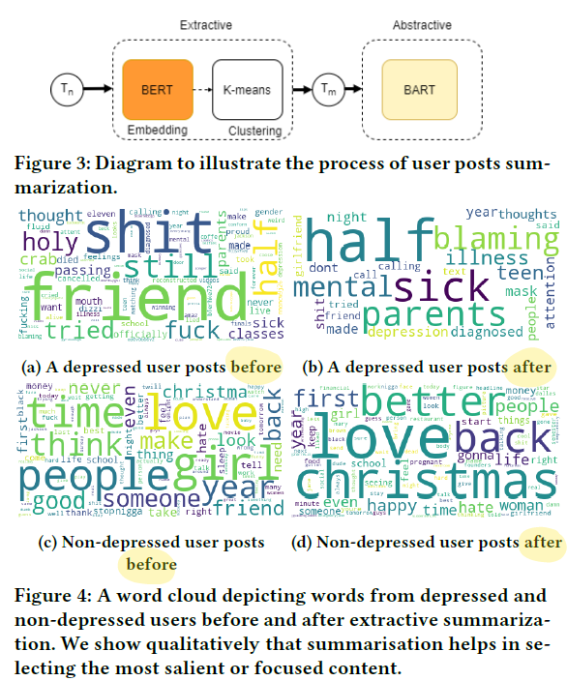
DepressionNet: A Novel Summarization Boosted Deep Framework for Depression Detection on Social Media

Slide 50
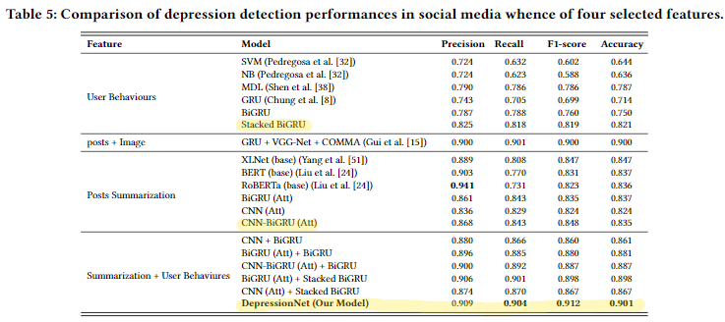
DepressionNet: A Novel Summarization Boosted Deep Framework for Depression Detection on Social Media

Slide 51
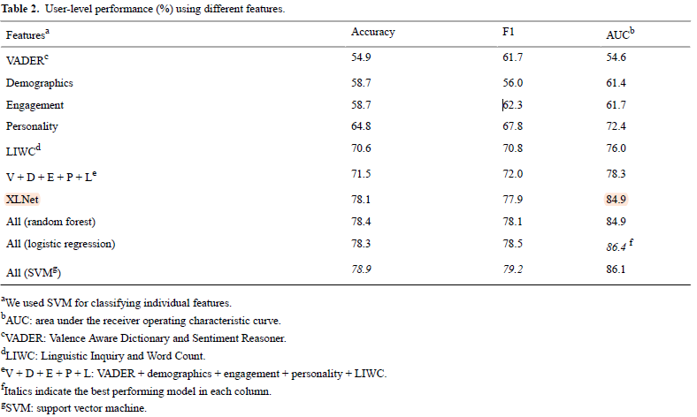
Monitoring Depression Trends on Twitter During the COVID-19 Pandemic: Observational Study
Notes:
The results have shown that using VADER, demographics, and social media engagement features alone does not help the classification by much.
Classifiers using personality features and LIWC features perform relatively better.
We then used these five feature groups and obtained a better result (accuracy 71.5%; F1 score 72.0%).
However, the classifier was still outperformed by XLNet, showing that the transformer-based models indeed worked better on depressive Twitter text modeling compared with other approaches.
We further increased the classifier’s performance by using all the features, namely, VADER, demographics, engagement, personality, and LIWC features, and the averaged
XLNet confidence score; the performance of the three machine learning algorithms did not vary much, and the SVM classifier achieved the best accuracy (78.9%) and F1 (79.2%) scores.

Slide 52
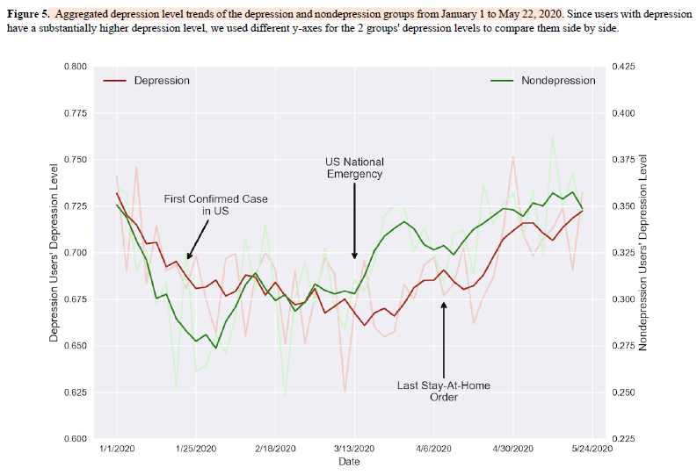
Monitoring Depression Trends on Twitter During the COVID-19 Pandemic: Observational Study
We ran the XLNet model on the preprocessed tweet chunks and recorded
the confidence scores.

Slide 53
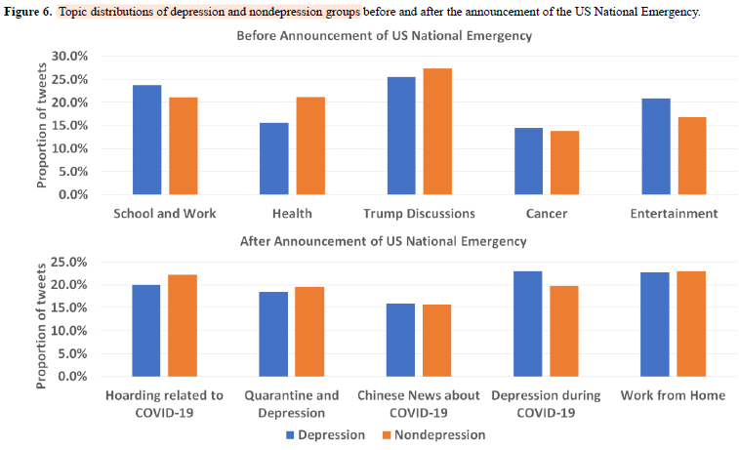
Monitoring Depression Trends on Twitter During the COVID-19 Pandemic: Observational Study

Slide 54
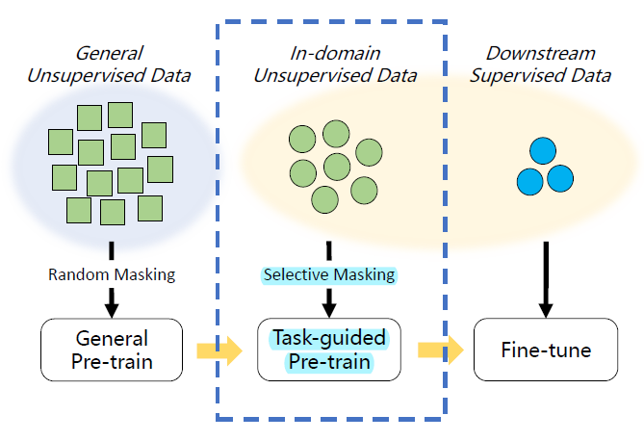
Train No Evil: Selective Masking for Task-Guided Pre-Training
Added task-guided pre-training between general pre-training and fine-tuning
Efficiently and effectively learn the domain-specific and task-specific language patterns
D(General) , D(Domain) , and D(Task)
Generally contain about 1000M words, 10M words, and 10K words

Slide 55
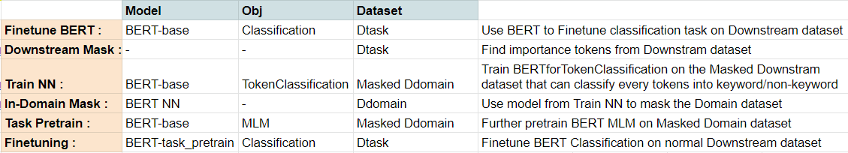
Train No Evil: Selective Masking for Task-Guided Pre-Training

Slide 56
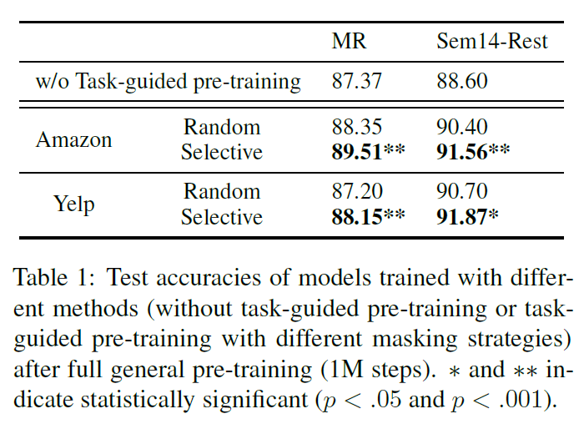
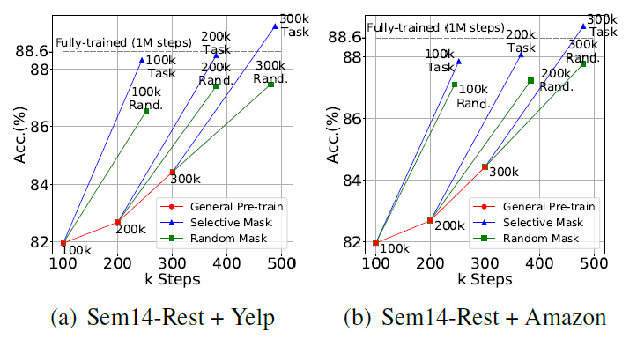
Train No Evil: Selective Masking for Task-Guided Pre-Training

Slide 57
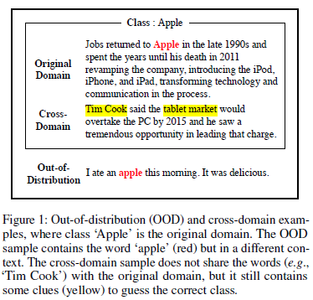
MASKER: Masked Keyword Regularization for Reliable Text Classification
Pre-trained models are not robust enough
empirically show that pre-trained models are still relying on undesirable dataset bias
Over-reliance problem is a type of shortcut bias (Geirhos et al. 2020), i.e., the model learns an easy-to-learn but not generalizable solution, as the keywords can be considered as a shortcut
Not always harmful as it can be a useful feature for in-distribution accuracy. However, we claim that they can be problematic for unexpected (i.e., OOD) samples
Our method further improves the generalization performance, applied to the pre-trained models.

Slide 58
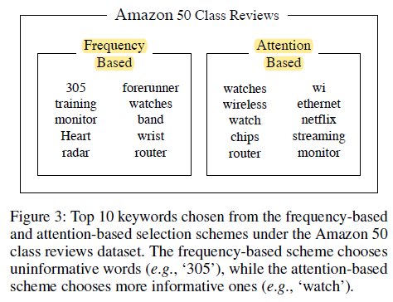
MASKER: Masked Keyword Regularization for Reliable Text Classification
The keyword set is the set of vocabularies which mostly affects to the prediction
Keyword Selection Scheme
Frequency-based : tokens with highest TF-IDF
Attention-based : tokens with highest attention values

Slide 59
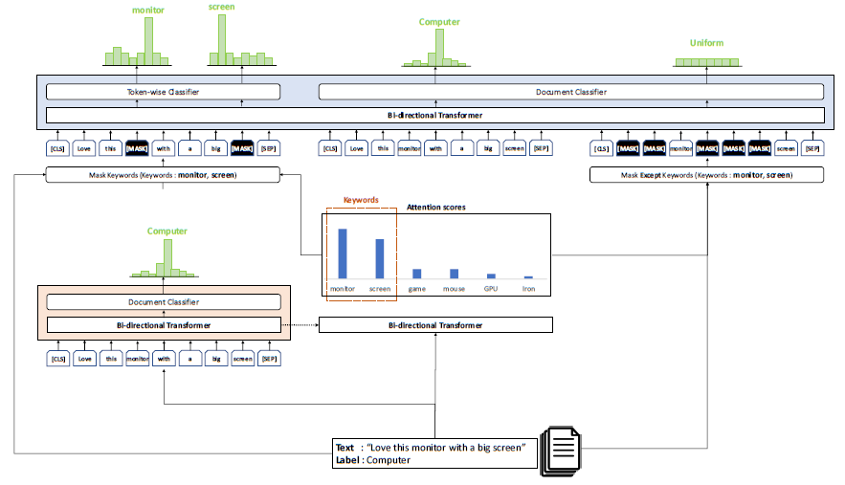
MASKER: Masked Keyword Regularization for Reliable Text Classification
Document classification : CrossEntropyLoss
Masked keyword reconstruction : forces the model to predict the masked keywords from understanding the context around them.
Masked entropy regularization : penalizes making high-confidence predictions from “cut-out-context” sentences, that non-keywords are randomly dropped.

Slide 60
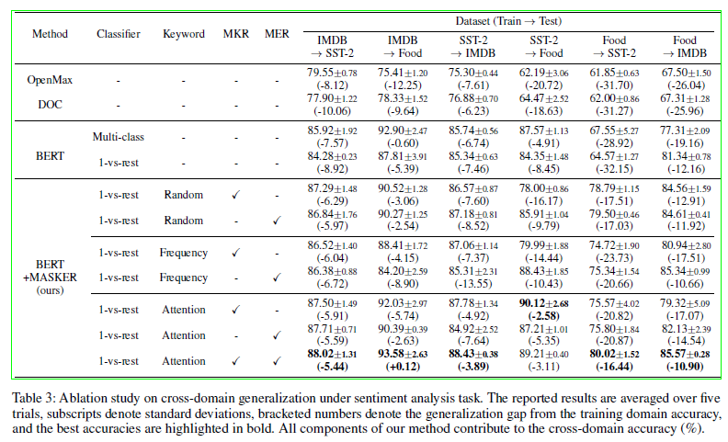
MASKER: Masked Keyword Regularization for Reliable Text Classification
Notes:
improves OOD detection and cross-domain generalization
without degrading classification accuracy

